Slide 1


E-COMMERCE PROGRESS

Slide 2
TOPICS
EC E-COMMERCE
SOCIAL MEDIA
MOBILE APPS

Slide 4
ELECTRONIC-CITY.NET

Slide 5
WEEKLY REPORT FOR
EC-COMMERCE

Slide 6
PENDINGS
BCA INTEGRASI
JNE RW BILL
CC PAYMENT METHODS

Slide 7
E-COMMERCE MARKET
SURVEYS AND MARKET DEMANDS

Slide 8
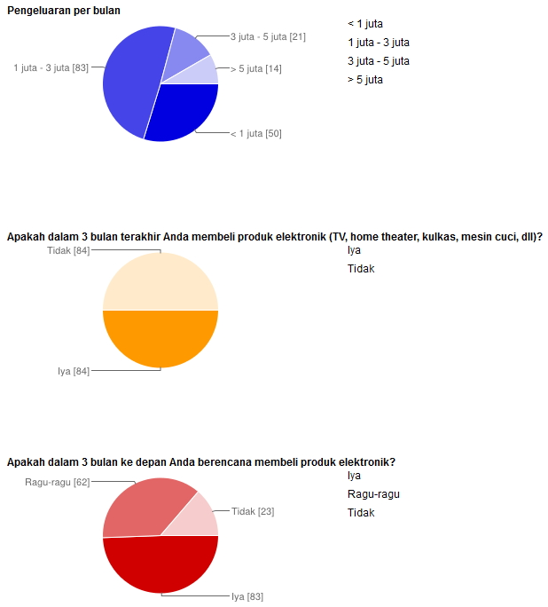
Our Market

Slide 9
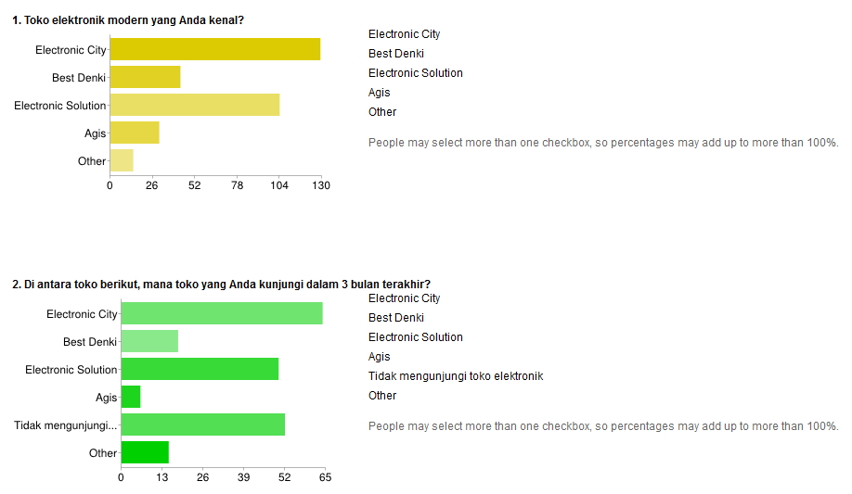
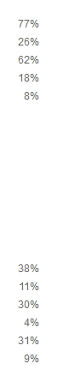
Our Market

Slide 10
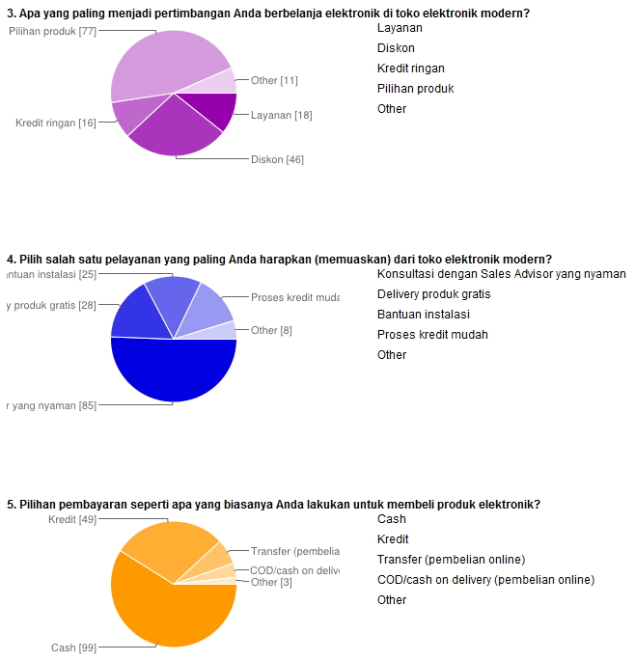
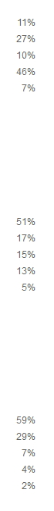
Our Market

Slide 11
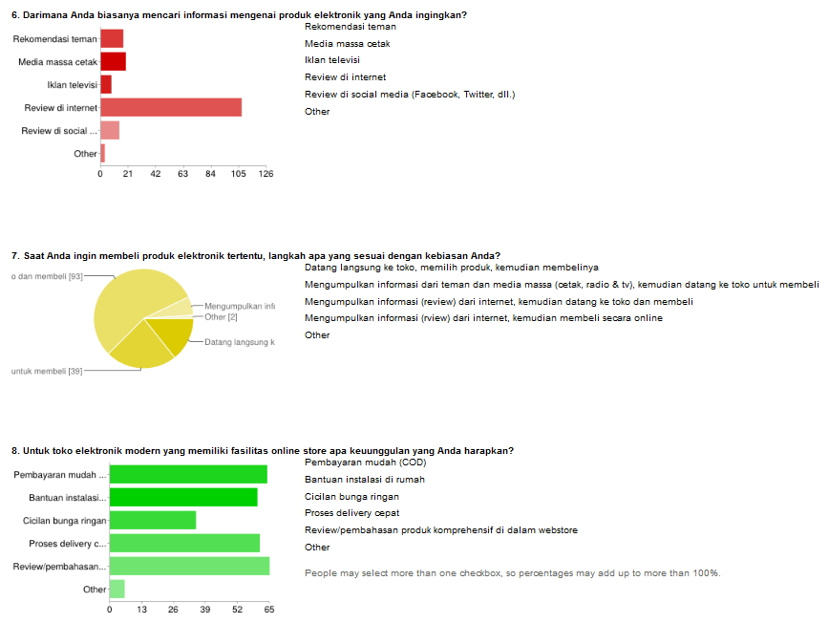
Our Market

Slide 12







SOCIAL MEDIA

Slide 13

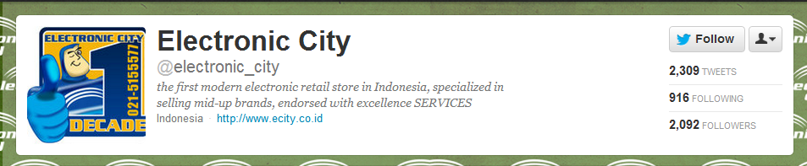
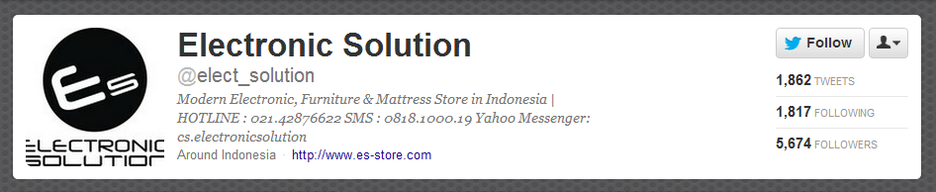
Social Media (Twitter) April

Slide 14
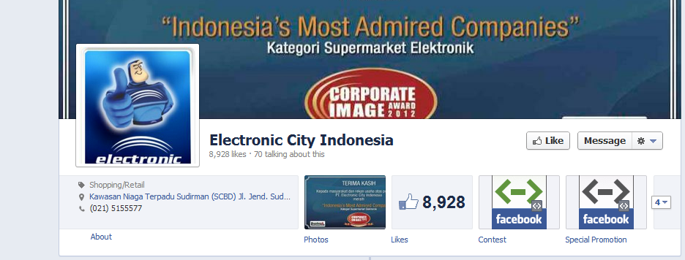
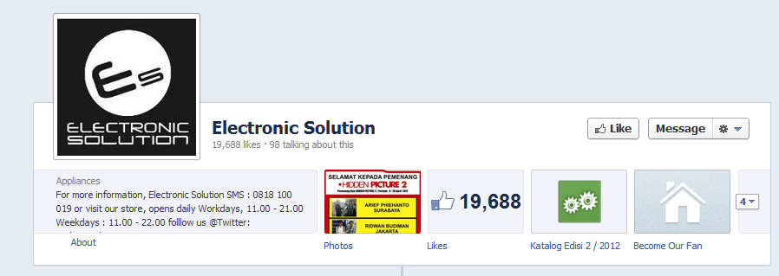

Social Media (Facebook)

Slide 15

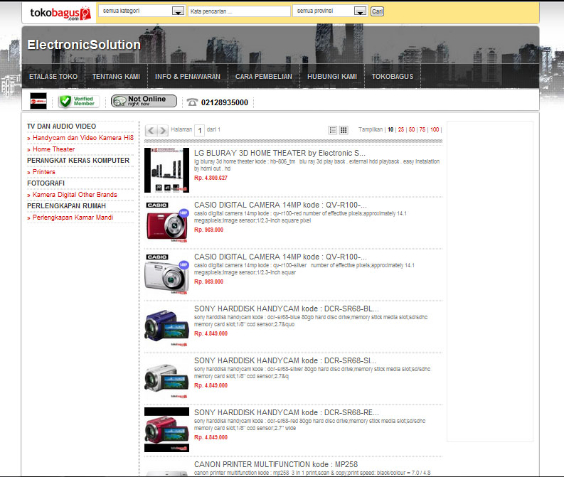
E-commerce ES

Slide 16
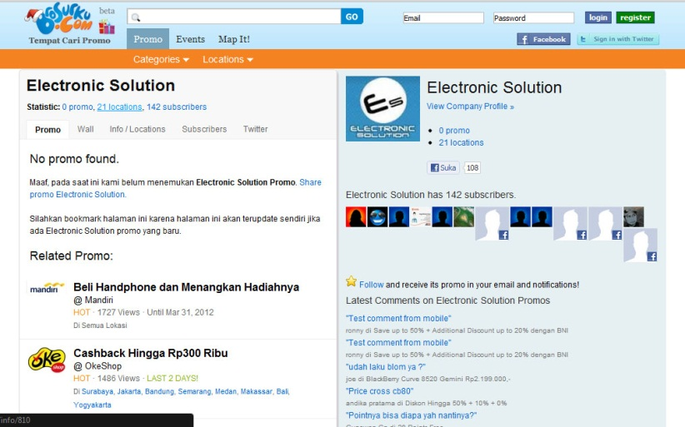
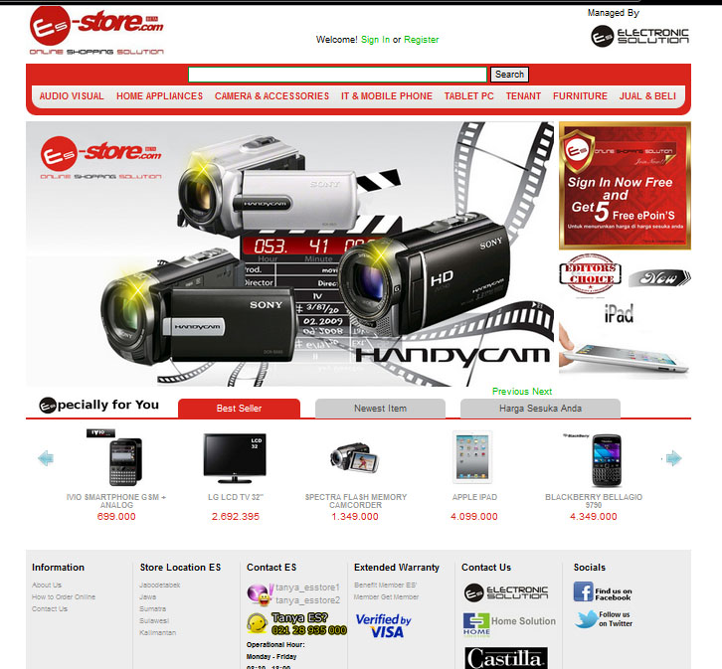
E-commerce ES

Slide 17
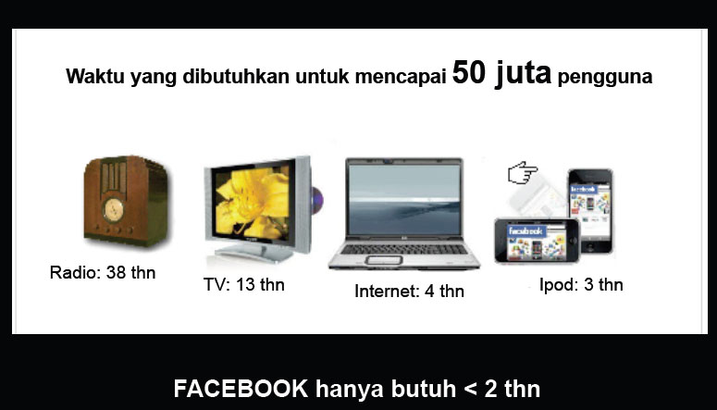
SOCIAL MEDIA

Slide 18
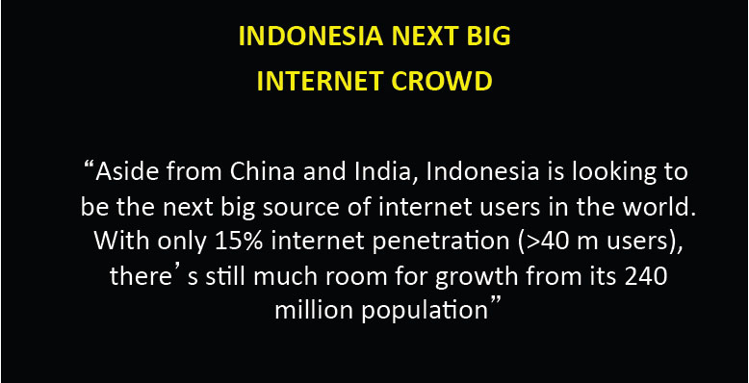
SOCIAL MEDIA

Slide 19
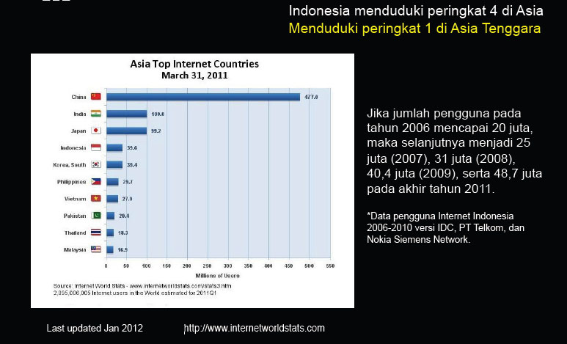
SOCIAL MEDIA

Slide 20
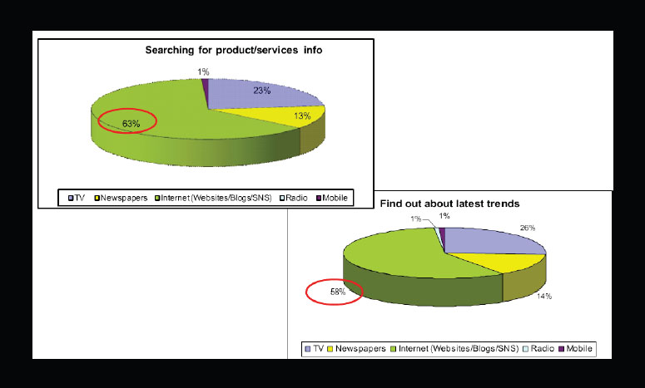
SOCIAL MEDIA

Slide 21

SOCIAL MEDIA

Slide 22

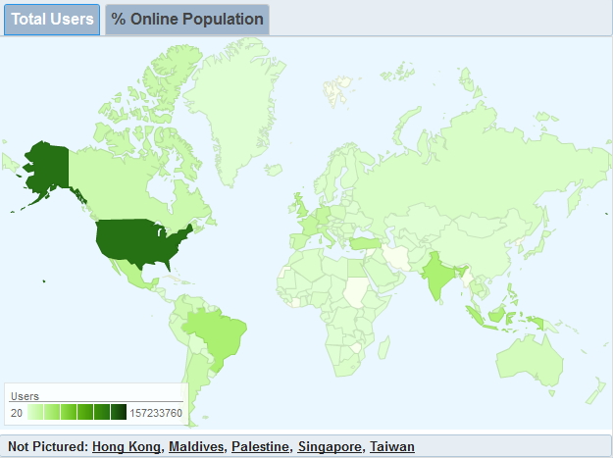
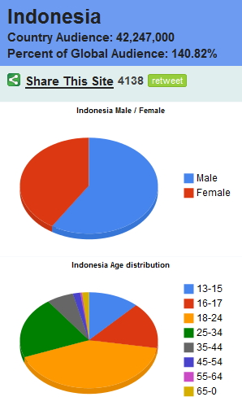
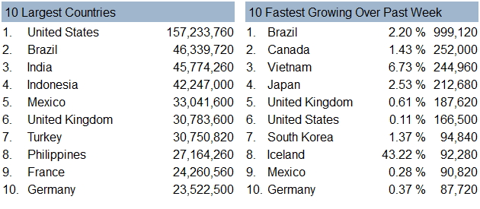
SOCIAL MEDIA

Slide 23
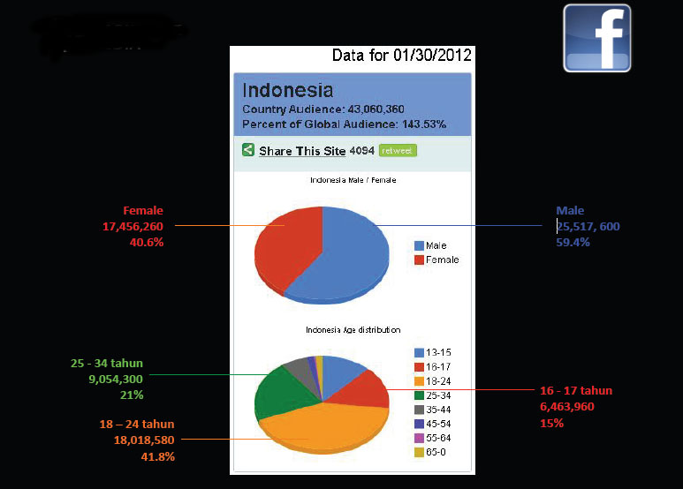
SOCIAL MEDIA

Slide 24
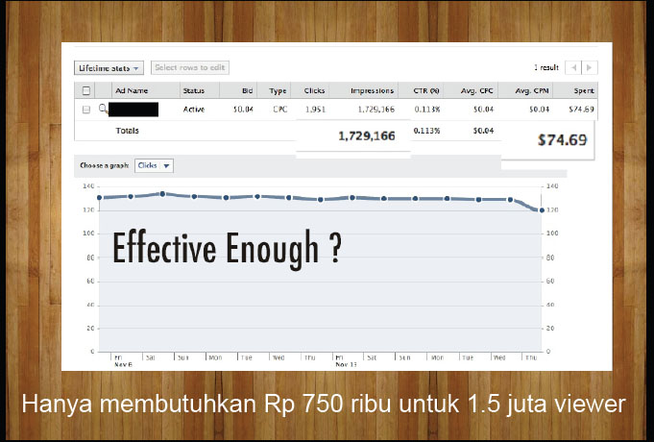
SOCIAL MEDIA

Slide 25
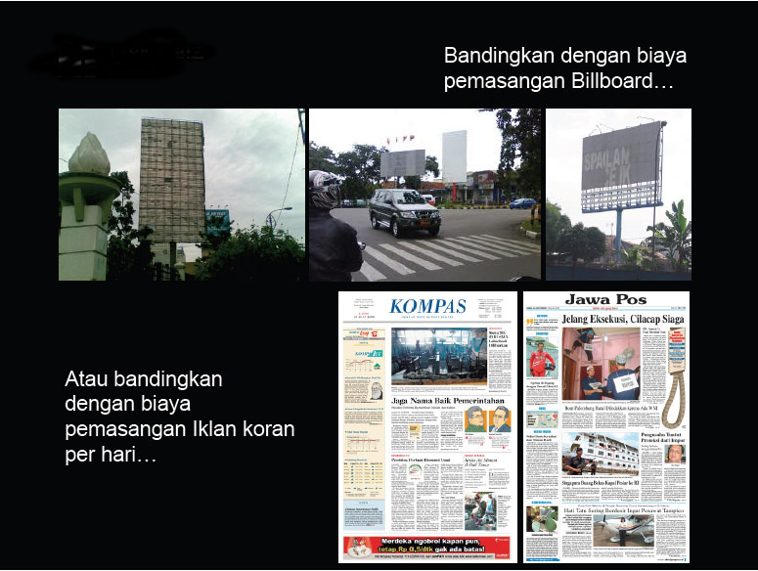
SOCIAL MEDIA

Slide 26

SOCIAL MEDIA

Slide 27
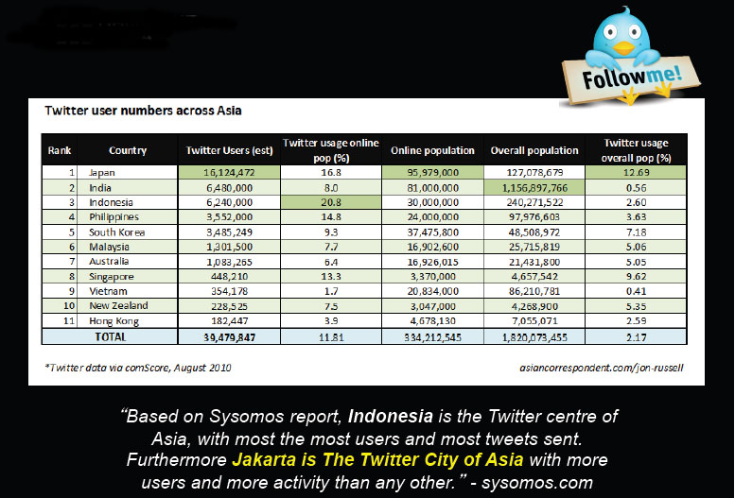
SOCIAL MEDIA

Slide 28
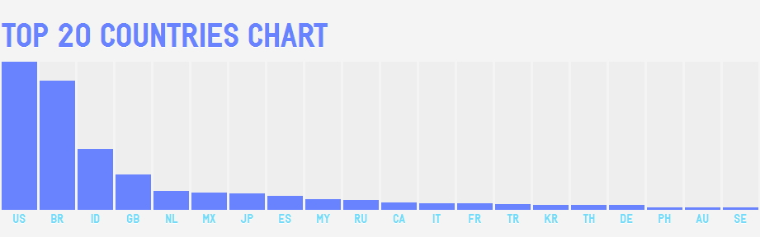
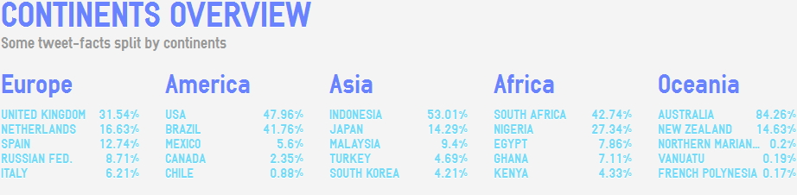

SOCIAL MEDIA

Slide 29
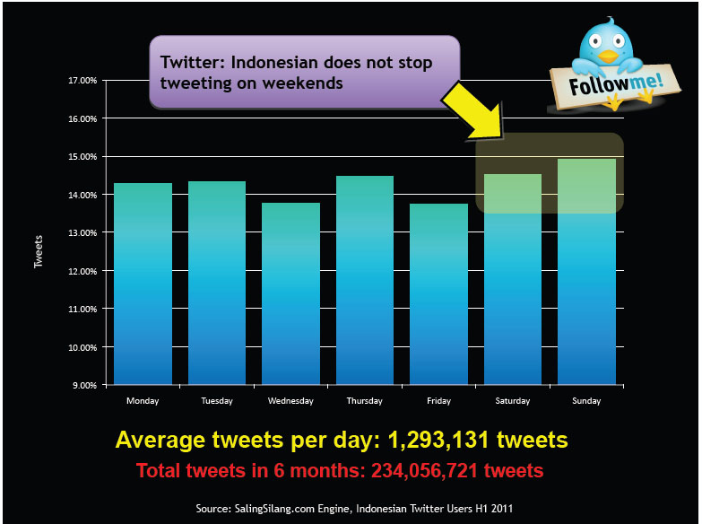
SOCIAL MEDIA

Slide 30
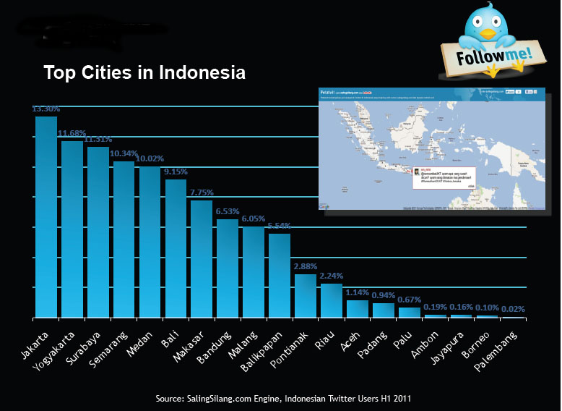
SOCIAL MEDIA

Slide 31
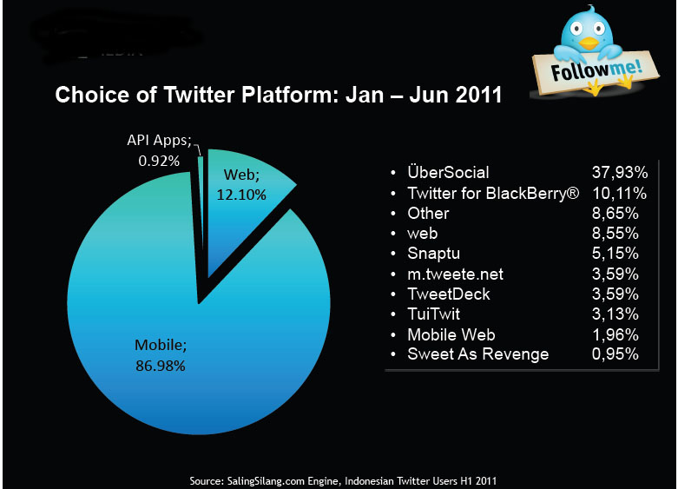
SOCIAL MEDIA

Slide 32
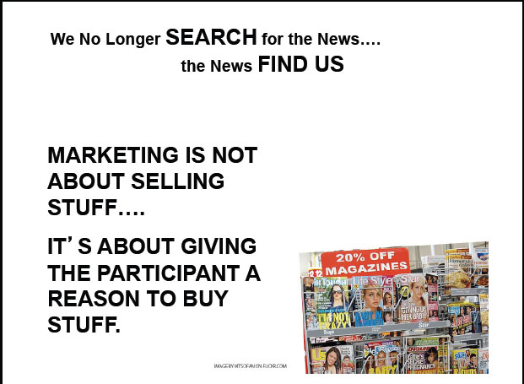
SOCIAL MEDIA

Slide 34

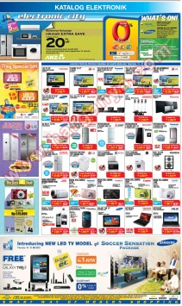
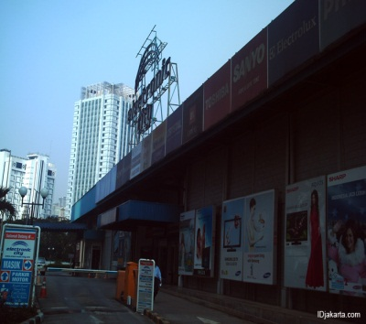
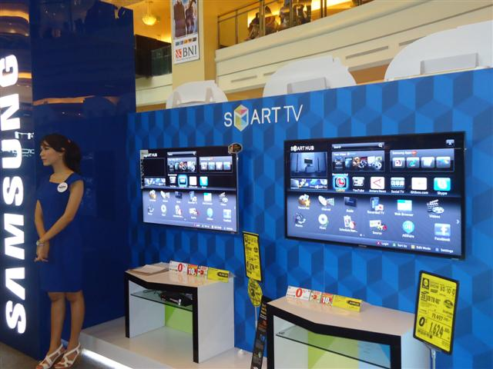


REAL STORE ILLUSTRATION

Slide 35

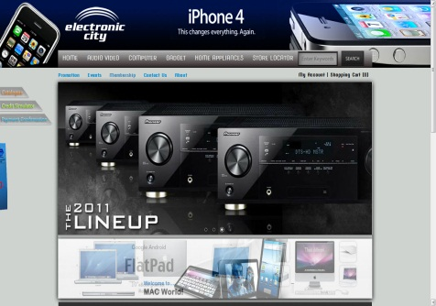
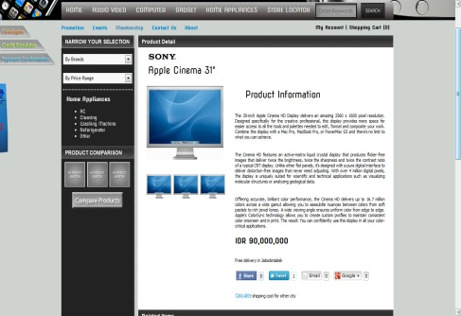

WEB STORE ILLUSTRATION

Slide 36
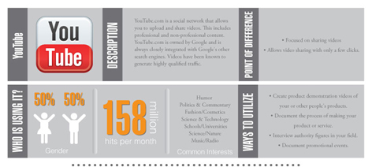

Slide 37
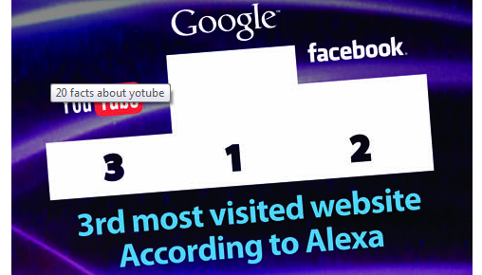

Slide 38


Slide 39
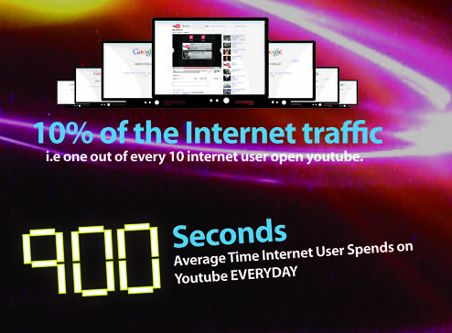

Slide 40
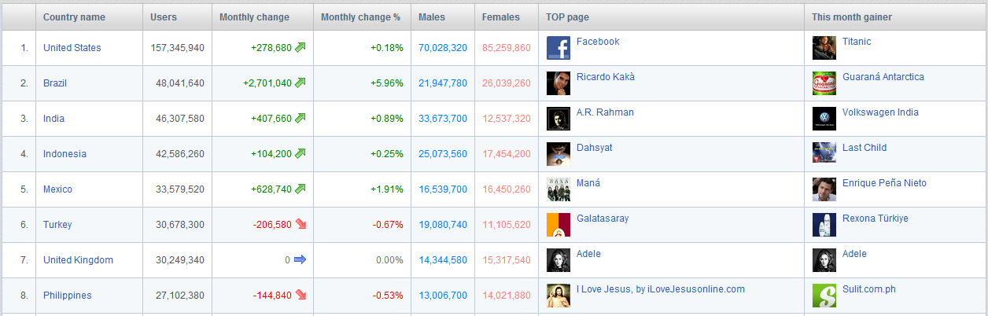

Slide 41

YOUTUBE ONLY
VIDEO SHARING

Slide 42
YOUTUBE IS ABOUT PROMOTING
YOUTUBE IS ABOUT BRANDING
YOUTUBE IS ABOUT
VISUAL MARKETING

Slide 43



VISUAL MARKETING
EXAMPLE
OVER 160 MILLION VIEWER,
CAN YOU FIGURE IF
THE CONVERSION RATE IS 0.1%
HOW MUCH HE MAKES?

Slide 44
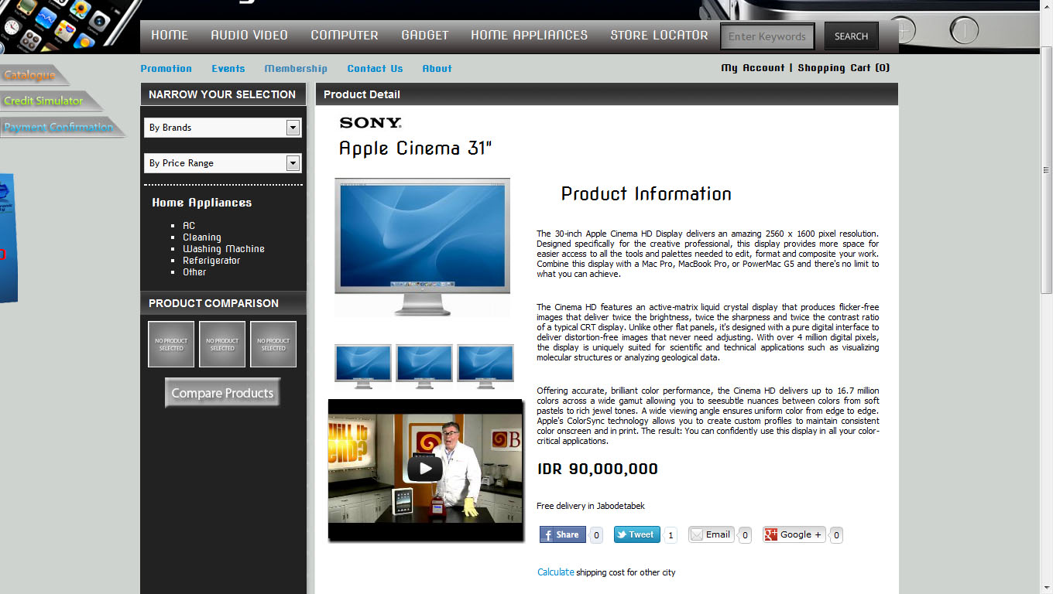
YOUTUBE VID ON DETAILS

Slide 45

Youtube ES ads for es-Store.com

Slide 46
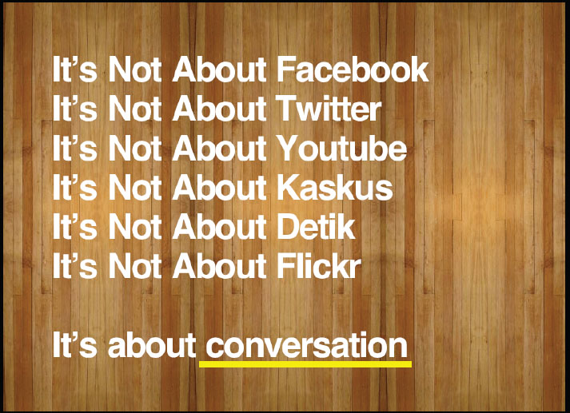
SOCIAL MEDIA

Slide 47

SOCIAL MEDIA

Slide 48



MOBILE APPS

Slide 49
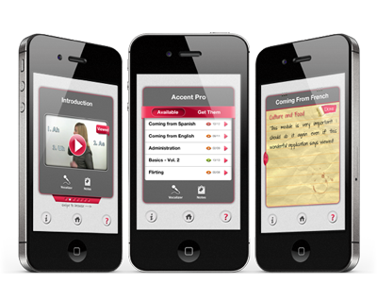
MOBILE APPS

Slide 50
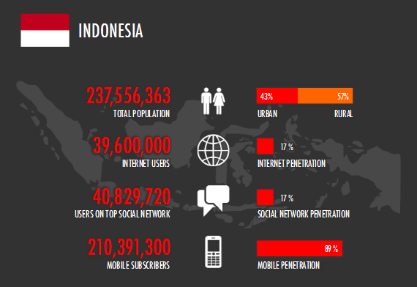
MOBILE APPS

Slide 51
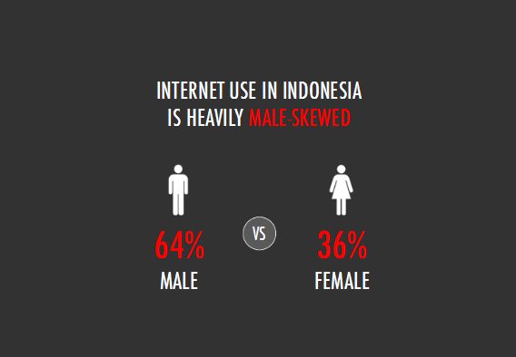
MOBILE APPS

Slide 52
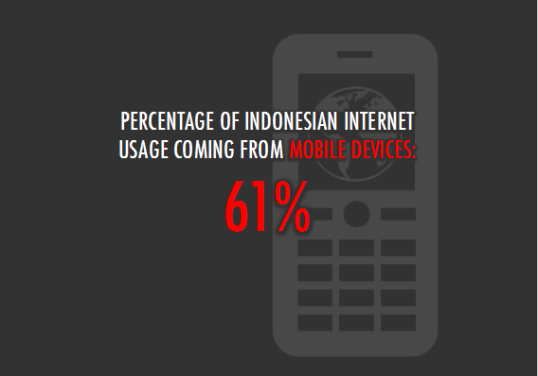
MOBILE APPS

Slide 53
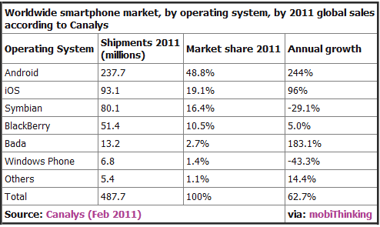
MOBILE APPS

Slide 54
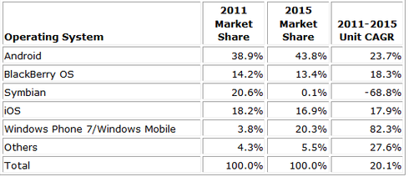
MOBILE APPS

Slide 55
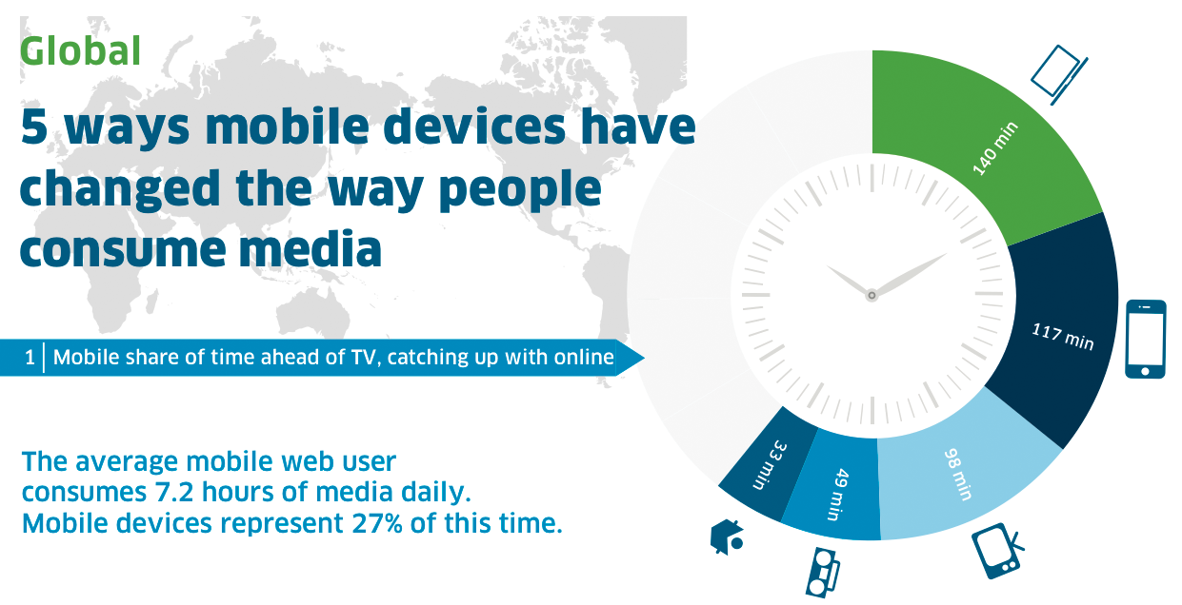
MOBILE APPS

Slide 56
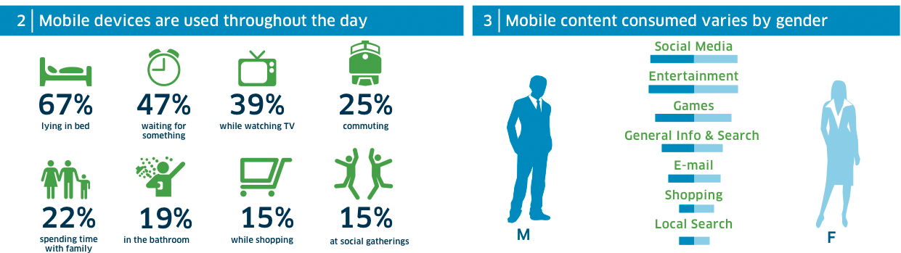
MOBILE APPS

Slide 57
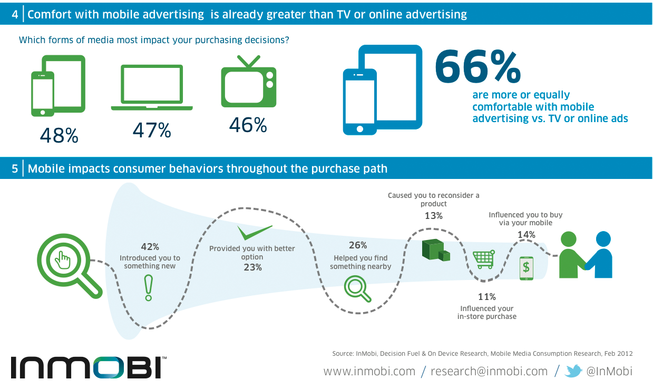
MOBILE APPS

Slide 58

MOBILE APPS

Slide 59


